Slide 1









My Number Interactive Notebook
$$×$$
$$\frac{1}{2}$$
$$÷$$
$$+$$
$$−$$
$$\frac{3}{5}$$
$$7$$
Name
Class
Teacher
Term 1 Semester 1
$$5^{2}$$
$$\sqrt{9}$$
1

Slide 2
Contents
Glossary or Formula Page
Page
Date
Description
2
3

Slide 3
Tasks
24
7
30
Essential Question
Questions
Notes
Summary

Slide 4
24
7
30
Date
Rounding
EQ – Describe the process of rounding a number to a given number of decimal places

Slide 5
Rounding Activity

Slide 6
24
7
30
Date
Rounding
EQ – Describe the process of rounding a number to a given number of decimal places
What are the rules for rounding to a number of decimal places?

Slide 7
24
7
30
Date
Rounding
EQ – Describe the process of rounding a number to a given number of decimal places
Rule Example
What are the rules for rounding to a number of decimal places?
Locate the digit in the required number of decimal places

Slide 8
24
7
30
Date
Rounding
EQ – Describe the process of rounding a number to a given number of decimal places
Rule Example
What are the rules for rounding to a number of decimal places?
Locate the digit in the required number of decimal places
Round to 3 decimal places (d.p)
2.689236

Slide 9
24
7
30
Date
Rounding
EQ – Describe the process of rounding a number to a given number of decimal places
Rule Example
What are the rules for rounding to a number of decimal places?
Locate the digit in the required number of decimal places
If the next digit is less than 5 then do nothing
If the next digit is 5 or more then round up.
Round to 3 decimal places (d.p)
2.689236

Slide 10
24
7
30
Date
Rounding
EQ – Describe the process of rounding a number to a given number of decimal places
Rule Example
What are the rules for rounding to a number of decimal places?
Locate the digit in the required number of decimal places
If the next digit is less than 5 then do nothing
If the next digit is 5 or more then round up.
Round to 3 decimal places (d.p)
2.689236
This digit is <5 so do nothing
Answer 2.689

Slide 11
24
7
30
Date
Rounding
EQ – Describe the process of rounding a number to a given number of decimal places
Rule Example
What are the rules for rounding to a number of decimal places?
Locate the digit in the required number of decimal places
If the next digit is less than 5 then do nothing
If the next digit is 5 or more then round up.
Round to 3 decimal places (d.p)
2.689236
This digit is <5 so do nothing
Answer 2.689
Round to 2 decimal places (d.p)
2.689236
This digit is >5 round up
Answer 2.69

Slide 12
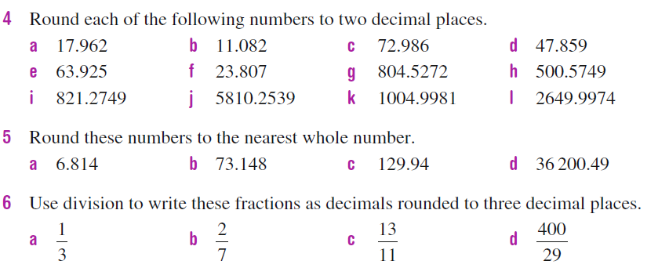
Questions

Slide 13


Answers

Slide 14
Notes Review
24, 7 ,30
Date
Title
Essential question
Notes complete
Notes complete with colour and diagrams
Questions completed
Contents page filed in
Formula page filled in

Slide 15
Homework
Review your notes and write a summary answering the essential question.

